Slide 1
Human Computer Interaction
Project Presentation
Ketan Panwar - PES1201700195
Tushar Raj - PES1201700221
Kanishk Singh - PES1201700223
Madhav Kashyap - PES1201700227

Slide 2
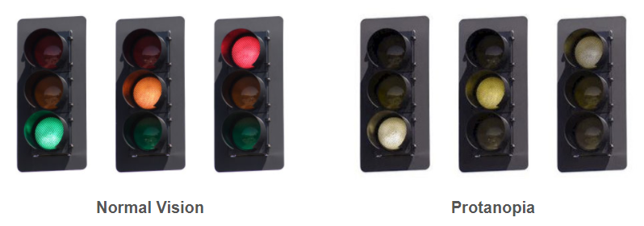
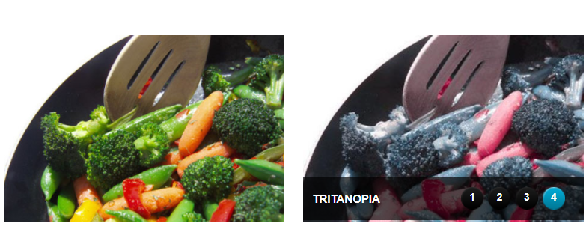
Needfinding
Colour blind people face many difficulties in everyday life which normally sighted people just aren’t aware of.
Problems can arise in even the simplest of activities including choosing and preparing food, gardening, sport, driving a car.
Taking the examples on the right, it’s evident how dangerous this disability can be.
The question arises as to how we can deal with this menace?
We also need to ensure that the different types of colorblindness are taken care of: ie Protanopia, Deuteranopia and Tritanopia
Notes:
Understanding the needs of the users

Slide 3
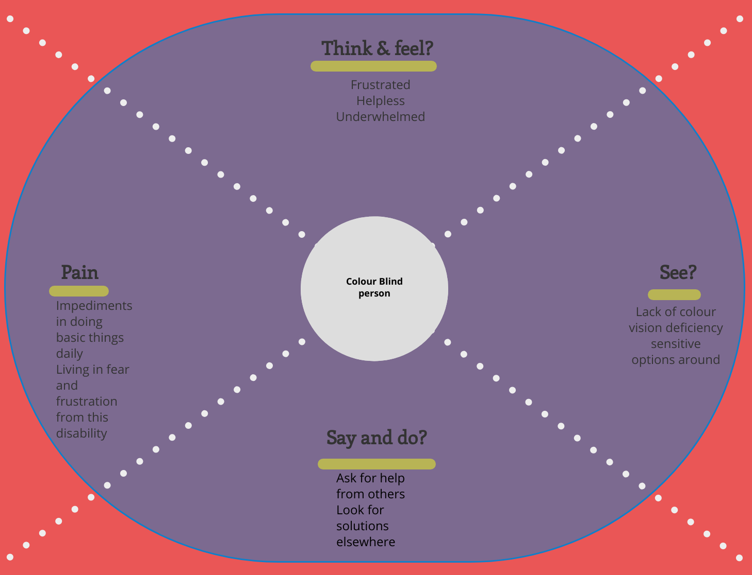
Empathy map
Notes:
Empathy generated after obtaining answers received from color blind people via a Google Docs questionnaire

Slide 4
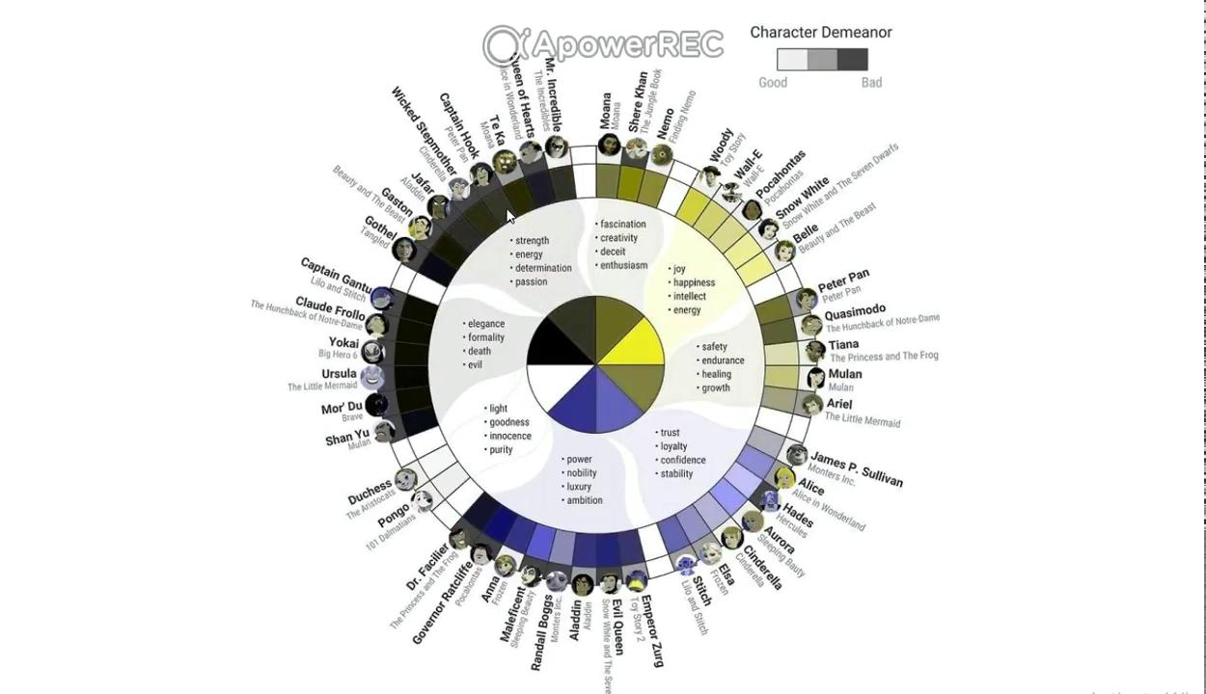
Concept Video
Notes:
Insert concept video here

Slide 5
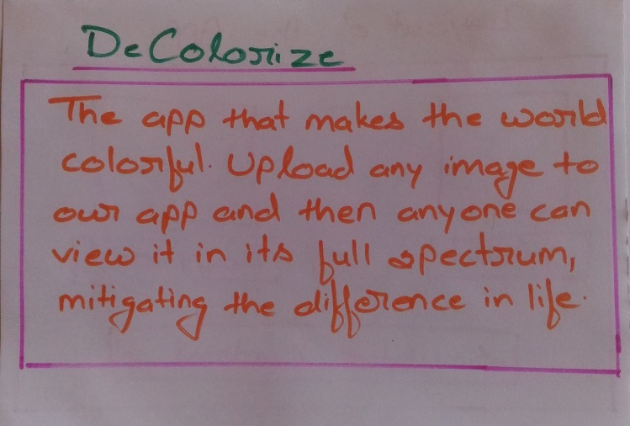
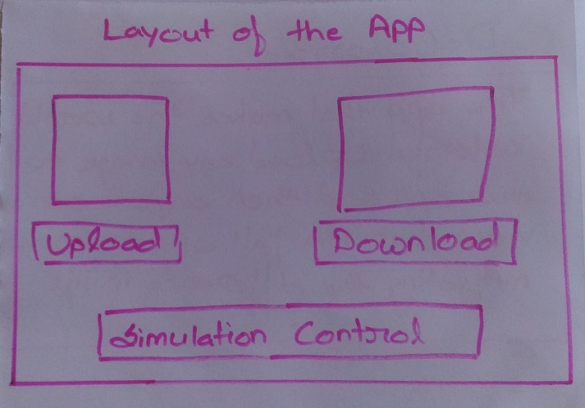
Low Fidelity Prototype

Slide 6
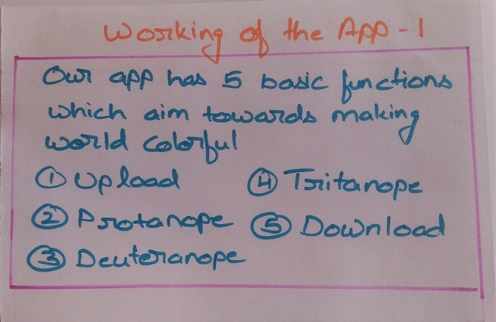
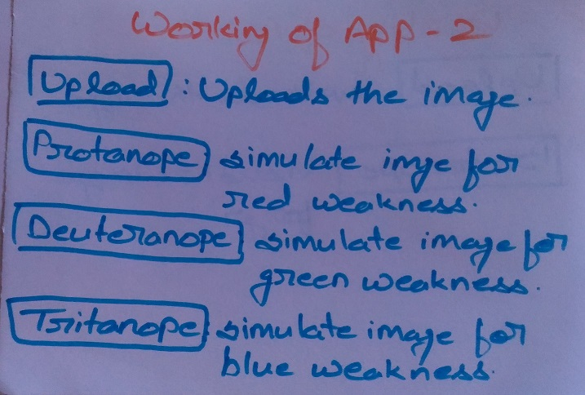
Low Fidelity Prototype (continued)

Slide 7
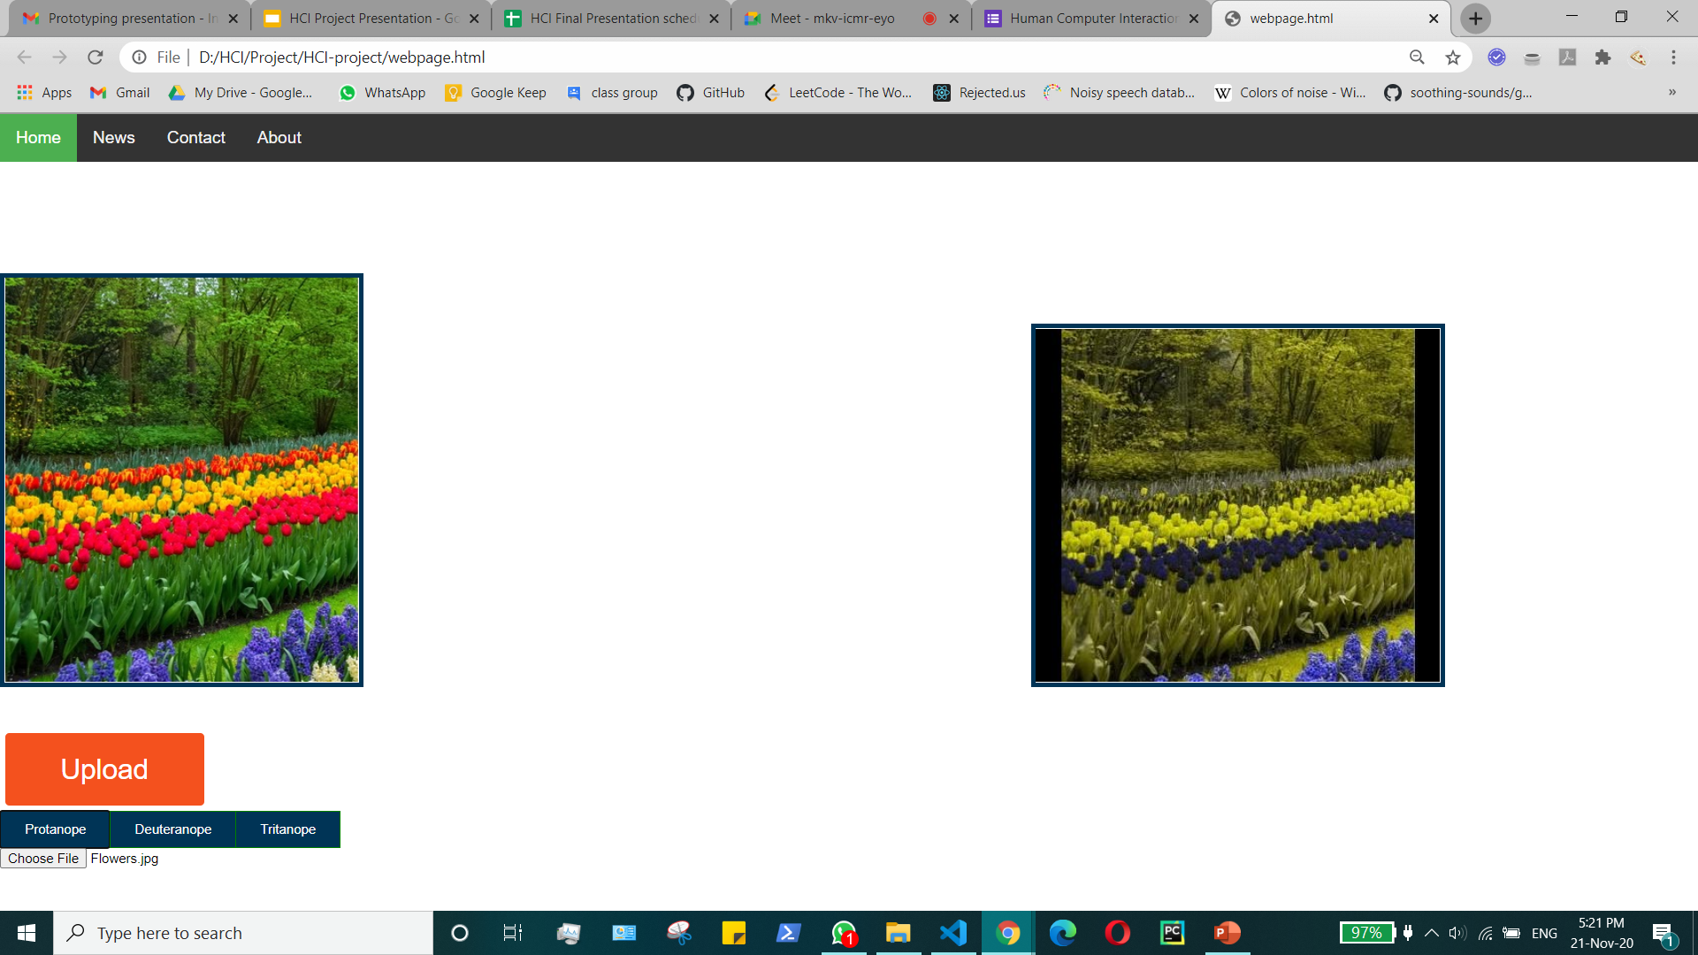
High Fidelity Prototype
Notes:
Add link to the website

Slide 8
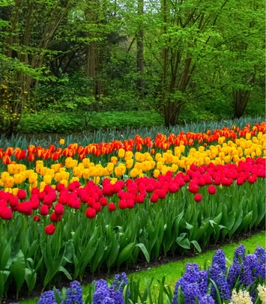
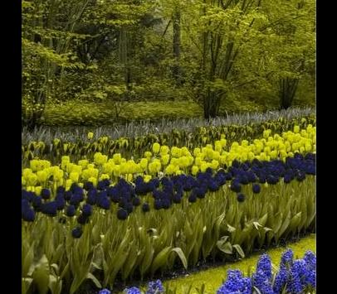
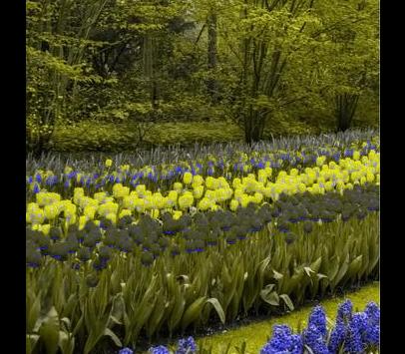
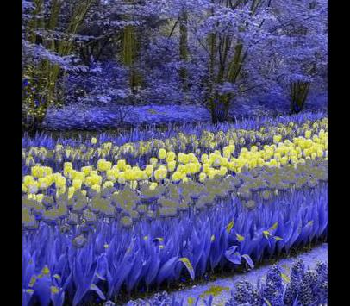
←: Original Image
Protanope : →
Tritanope : →
←: Deuteranope:
Notes:
Add link to the website

Slide 9
Technology Used
Backend Server: Python Flask, opencv library
Frontend: Javascript, CSS, HTML - t0 provide framework for the frontend of the website

Slide 10
Heuristic Evaluation
Visibility of system status - System outputs the appropriate image
User control and freedom - User has the freedom to input any image he wishes to
Recognition rather than recall - Instructions for use are very clear and no recall is required
Help and documentation - Minimal documentation is required
Consistency & standards - The system is consistent with all images
Aesthetic and minimalist design - Only information which is relevant is provided
Notes:
Heuristic evaluation is a thorough assessment of a product's user interface, and its purpose is to detect usability issues that may occur when users interact with a product, and identify ways to resolve them.

Slide 11
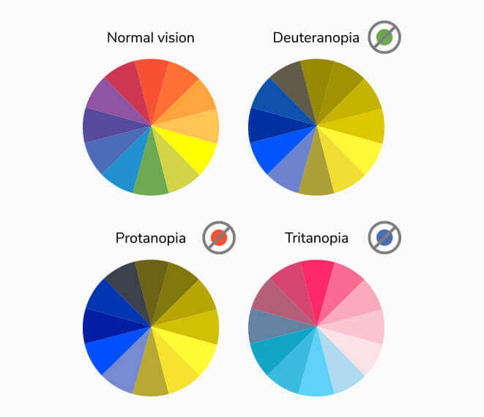
Use Cases
Helps designers create more accessibility for color blind affected users.
12 % of men suffer from color blindness. 1 % of females suffer as well.
Redesign color palettes designs for Websites.
Redesign color palettes designs for Scientific graphs and plots.
Notes:
Heuristic evaluation is a thorough assessment of a product's user interface, and its purpose is to detect usability issues that may occur when users interact with a product, and identify ways to resolve them.

Slide 12
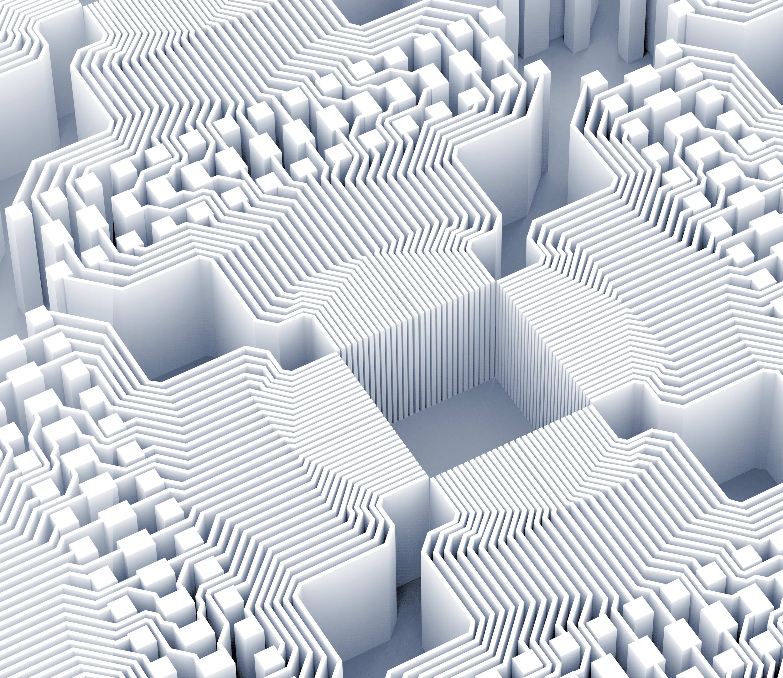
Thank you!

